Slide 1
Demo-2
Team A3 Sergei, Jannes, Sander, Pascal, Vis de Boer & de Blauwe Trekker
Demo 2
Sergei
Jannes
Sander
Pascal

Slide 2
Scheme

Slide 3
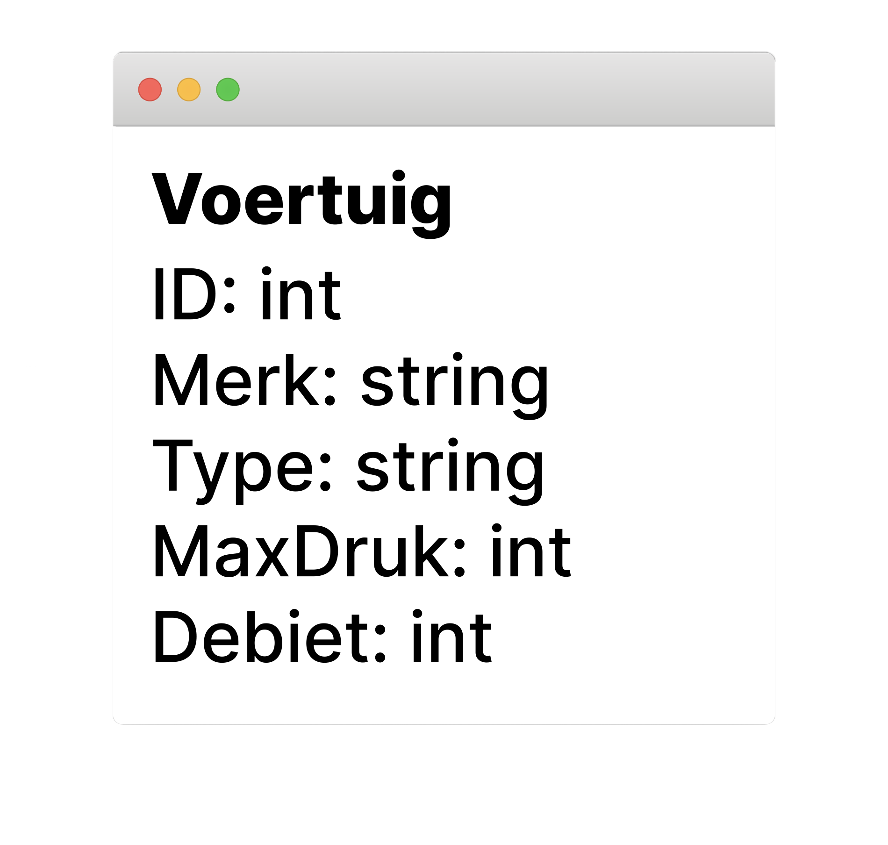
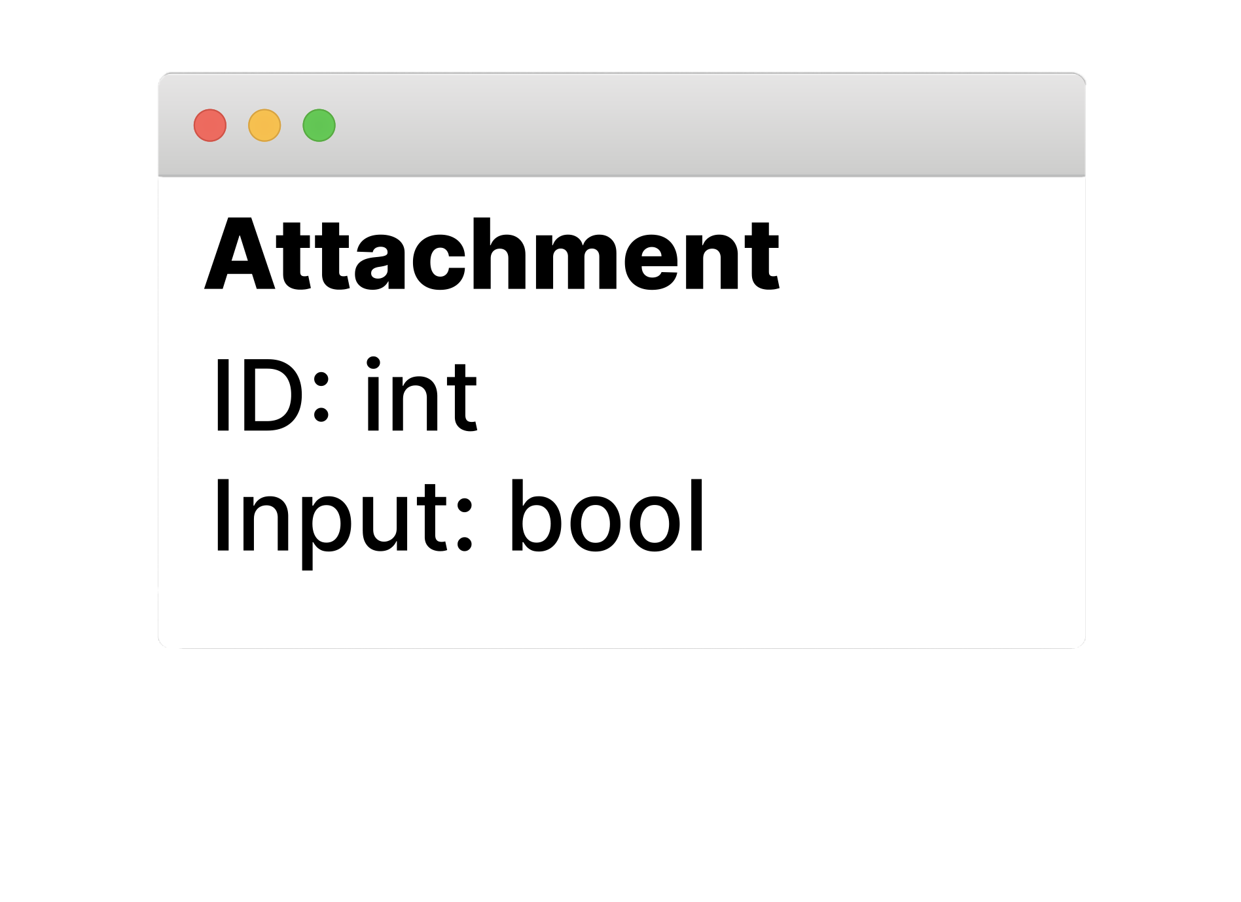
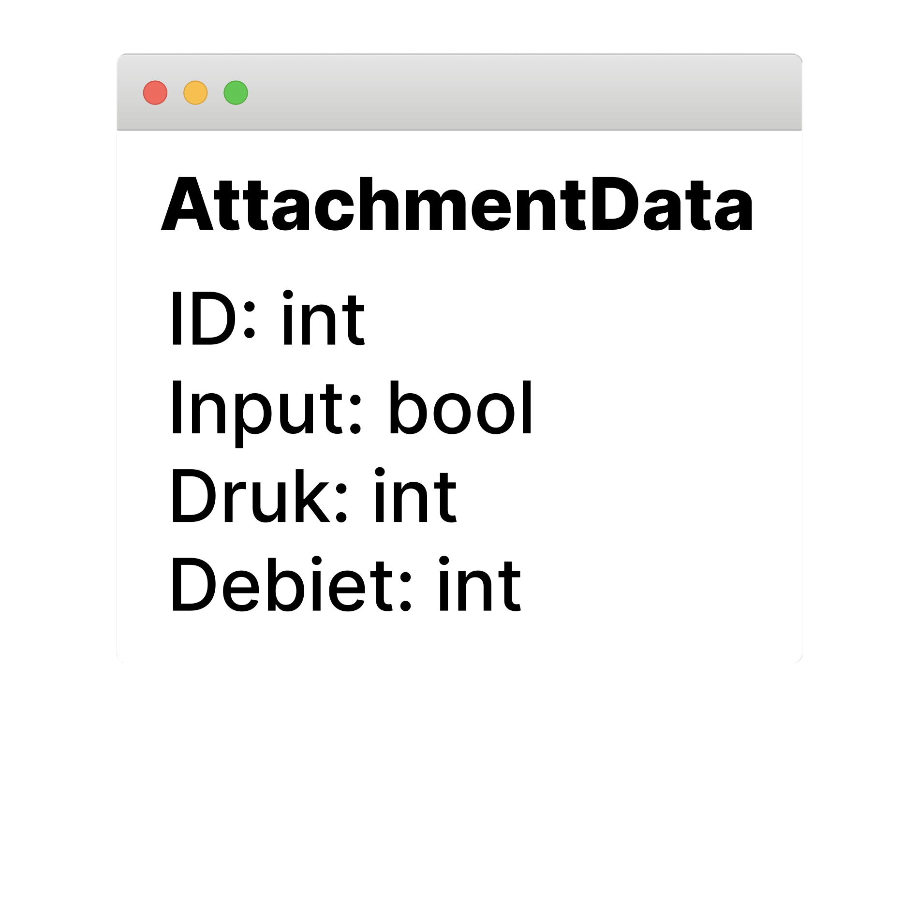
Database

Slide 4



Android
iOS

